Slide 1
Controlling

Slide 2
What Is Controlling
Controlling: management function that involves monitoring, comparing, and correcting work performance
Notes:
What is controlling? It’s the process of monitoring, comparing, and correcting work performance. All managers should control even if their units are performing as planned because they can’t really know that unless they’ve evaluated what activities have been done and compared actual performance against the desired standard.
Effective controls ensure that activities are completed in ways that lead to the attainment of goals. Whether controls are effective, then, is determined by how well they help employees and managers achieve their goals.

Slide 3
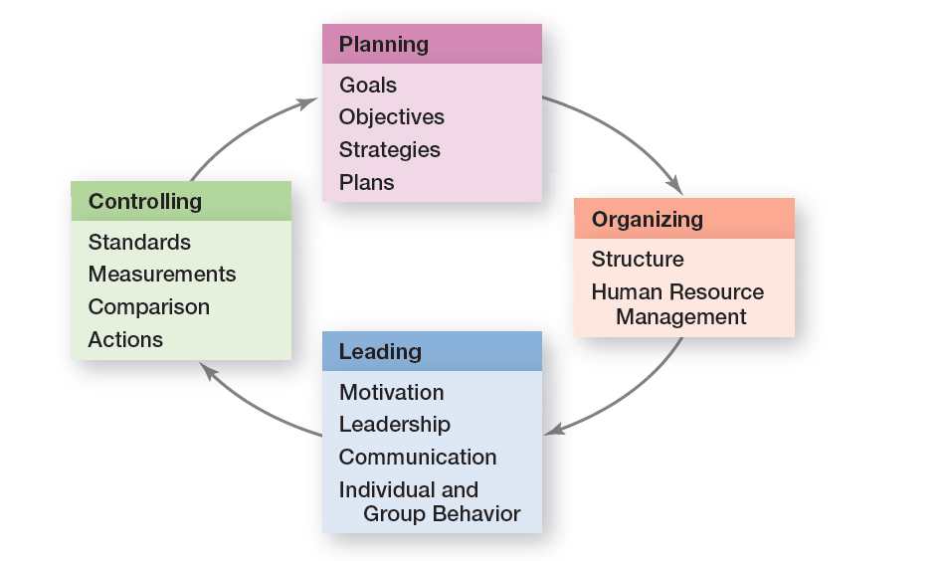
Planning-Controlling Link
Exhibit 18-1 shows shows how controlling provides a critical link back to planning.
Notes:
Controlling provides a critical link back to planning (see Exhibit 18-1). If managers didn’t control, they’d have no way of knowing whether their goals and plans were being achieved and what future actions to take.

Slide 4
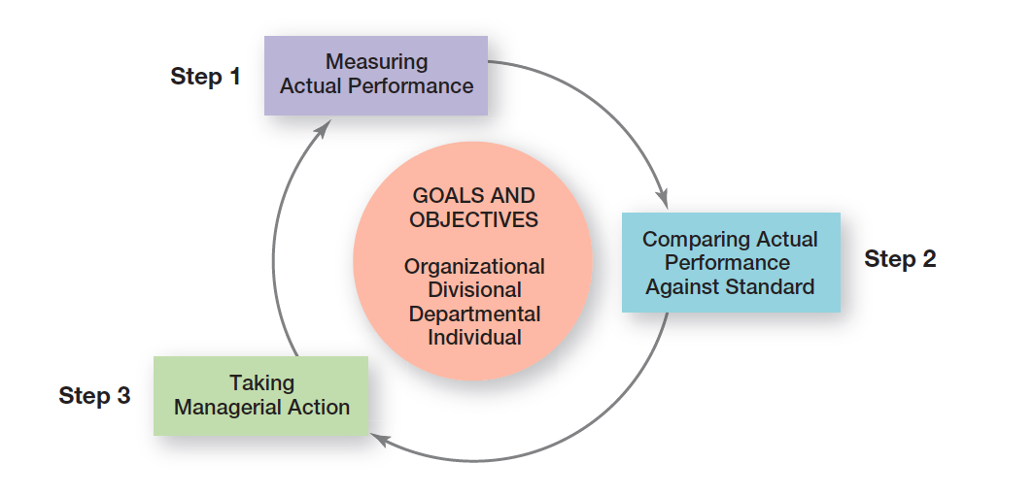
The Control Process
Exhibit 18-2 illustrates the three-step control process.

Slide 5
Taking Managerial Action
Correct actual performance
  Immediate corrective action: corrective action that corrects problems at once to get performance back on track
  Basic corrective action: corrective action that looks at how and why performance deviated before correcting the source of deviation
Notes:
Managers can choose among three possible courses of action: do nothing, correct the actual performance, or revise the standards. Because “do nothing” is self-explanatory, let’s look at the other two.
One decision a manager must make is whether to take immediate corrective action, which corrects problems at once to get performance back on track, or to use basic corrective action, which looks at how and why performance deviated before correcting the source of deviation.

Slide 6
Revise the Standard
  If performance consistently exceeds the goal, then a manager should look at whether the goal is too easy and needs to be raised.
  Managers must be cautious about revising a standard downward.
Notes:
It’s possible that the variance was a result of an unrealistic standard—too low or too high a goal. In that situation, the standard needs the corrective action, not the performance. If performance consistently exceeds the goal, then a manager should look at whether the goal is too easy and needs to be raised. On the other hand, managers must be cautious about revising a standard downward.

Slide 7
Feedforward/Concurrent/Feedback Controls
  Feedforward control: control that takes place before a work activity is done
  Concurrent control: control that takes place while a work activity is in progress. Management by walking around - a term used to describe when a manager is out in the work area interacting directly with employees
  Feedback control: control that takes place after a work activity is done
Notes:
The most desirable type of control—feedforward control—prevents problems because it takes place before the actual activity. The key to feedforward controls is taking managerial action before a problem occurs. That way, problems can be prevented rather than having to correct them after any damage (poor-quality products, lost customers, lost revenue, etc.) has already been done.
Concurrent control, as its name implies, takes place while a work activity is in progress.
The best-known form of concurrent control is direct supervision. Another term for it is management by walking around, which is when a manager is in the work area interacting directly with employees.
The most popular type of control relies on feedback. In feedback control, the control takes place after the activity is done. Feedback controls have two advantages. First, feedback gives managers meaningful information on how effective their planning efforts were. Feedback that shows little variance between standard and actual performance indicates that the planning was generally on target. Second, feedback can enhance motivation. People want to know how well they’re doing and feedback provides that information.

Slide 8
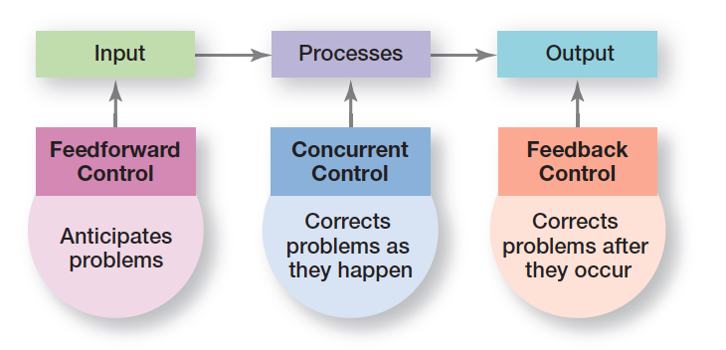
Types of Control
Exhibit 18-9 shows the three kinds of control
Notes:
Managers can implement controls before an activity begins, during the time the activity is going on, and after the activity has been completed. The first type is called feedforward control; the second, concurrent control; and the last, feedback control (see Exhibit 18-9).

Slide 9
Information Controls
  Management information system (MIS): a system used to provide management with needed information on a regular basis
Notes:
In measuring actual performance, managers need information about what is happening within their area of responsibility and about the standards in order to be able to compare actual performance with the standard.
A management information system (MIS) is a system used to provide managers with needed information on a regular basis. In theory, this system can be manual or computer-based, although most organizations have moved to computer-supported applications. The term system in MIS implies order, arrangement, and purpose. Further, an MIS focuses specifically on providing managers with information (processed and analyzed data), not merely data (raw, unanalyzed facts).

Slide 10
Balanced Scorecard
  Balanced scorecard: a performance measurement tool that looks at more than just the financial perspective
Notes:
The balanced scorecard approach is a way to evaluate organizational performance from more than just the financial perspective.
A balanced scorecard typically looks at four areas that contribute to a company’s performance: financial, customer, internal processes, and people/innovation/growth assets. According to this approach, managers should develop goals in each of the four areas and then measure whether the goals are being met.

Slide 11
Benchmarking of Best Practices
  Benchmark: the standard of excellence against which to measure and compare
Notes:
Benchmarking is the search for the best practices among competitors or noncompetitors that lead to their superior performance. Benchmarking should identify various benchmarks, the standards of excellence against which to measure and compare.

Slide 12
Workplace Privacy
Employers can read your e-mail, tap your telephone, monitor your work by computer, store and review computer files.
Reasons companies monitor:
  Productivity/Internet traffic
  Concerns about offensive/inappropriate material
  Protecting company secrets
Notes:
If you work, do you think you have a right to privacy at your job? What can your employer find out about you and your work? You might be surprised at the answers! Employers can (and do), among other things, read your e-mail (even those marked “personal or confidential”), tap your telephone, monitor your work by computer, store and review computer files, monitor you in an employee bathroom or dressing room, and track your whereabouts in a company vehicle.
And these actions aren’t that uncommon. In fact, some 26 percent of companies have fired an employee for e-mail misuse; 26 percent have fired workers for misusing the Internet; 6 percent have fired employees for inappropriate cell phone use; 4 percent have fired someone for instant messaging misuse; and 3 percent have fired someone for inappropriate text messaging.

Slide 13
Employee Theft
Employee theft: any unauthorized taking of company property by employees for their personal use
Notes:
Employee theft is defined as any unauthorized taking of company property by employees for their personal use. It can range from embezzlement to fraudulent filing of expense reports to removing equipment, parts, software, or office supplies from company premises. Managers need to educate themselves about this control issue and be prepared to deal with it.
Thankfully the number of workplace shootings has decreased. However, the U.S. National Institute of Occupational Safety and Health still says that each year, some 2 million American workers are victims of some form of workplace violence. In an average week, one employee is killed and at least 25 are seriously injured in violent assaults by current or former coworkers.

Slide 14
Types of Discipline Problems and Examples of Each
Problem Type | Examples of Each
Attendance | Absenteeism, tardiness, abuse of sick leave
On-the-Job Behaviors | Insubordination, failure to use safety devices, alcohol or drug abuse
Dishonesty | Theft, lying to supervisors, falsifying information on employment application or on other organizational forms
Outside Activities | Criminal activities, unauthorized strike activities, working for a competing organization (if no-compete clause is part of employment)
Notes:
Exhibit 18-8 lists some common types of work discipline problems and examples of each. In those circumstances, it’s important for a manager to know what the organization’s policies are on discipline. Is there a process for dealing with unsatisfactory job performance? Do warnings need to be given when performance is inadequate? What happens if after the warnings, performance or the troublesome behavior doesn’t improve? Disciplinary actions are never easy or pleasant; however, discipline can be used to both control and correct employee performance, and managers must know how to discipline.

Slide 15
Controlling for Employee Performance
  Disciplinary action: actions taken by a manager to enforce the organization’s work standards and regulations
Notes:
It’s particularly important for managers to deliver effective performance feedback and to be prepared, if needed, to use disciplinary actions—actions taken by a manager to enforce the organization’s work standards and regulation.
We like to know how we’re doing. Managers need to provide their employees with feedback so that the employees know where they stand in terms of their work. When giving performance feedback, both parties need to feel heard, understood, and respected. And if done that way, positive outcomes can result.
Progressive disciplinary action is intended to ensure that the minimum penalty appropriate to the offense is imposed.

Slide 16
Thank you

